Slide 1
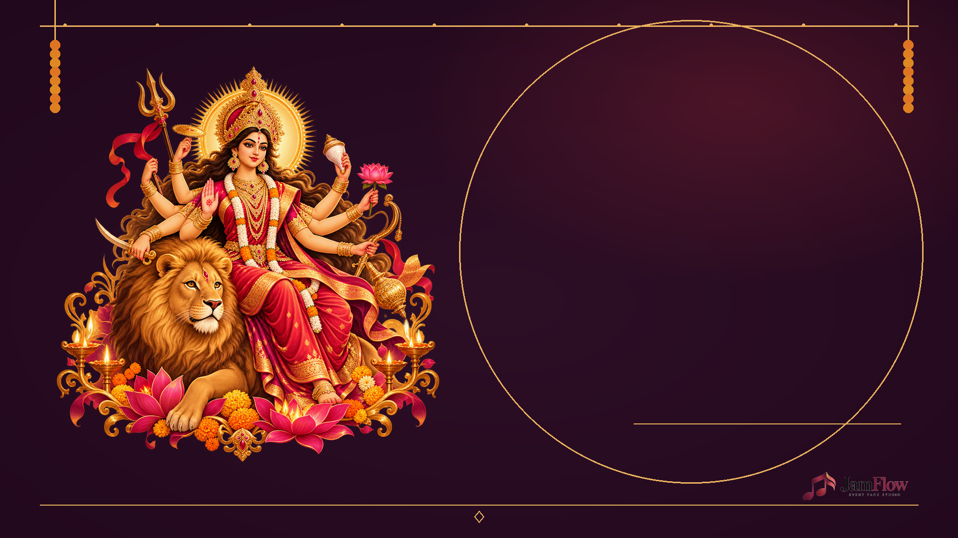
N A V R A T R I
SPECIAL
Durga Puja · Devi Aradhana
YOUR SONGS. READY FOR THE ROOM.
Sanskrit · Hindi · Telugu · English
68-MINUTE COMMUNITY SINGALONG | 16 MOMENTS
Original singalong lyrics + traditional chants

Slide 2

JAMFLOW / NAVRATRI SPECIAL
YOUR PROGRAM
TONIGHT, WE SING TOGETHER
INVOCATION • MULTILINGUAL SONGS
COMMUNITY DANCE • BLESSING
Follow your local event leader for rituals and aarti order.
Host and projection copy

Slide 3

JAMFLOW / NAVRATRI SPECIAL
GATHERING MOMENT
Opening: lamps & welcome
HOST / COMMUNITY
01 · 3 min

Slide 4
JAMFLOW / NAVRATRI SPECIAL
TRADITIONAL CHANT
Ya Devi Sarvabhuteshu
SING TOGETHER
02 · Sanskrit · 4 min

Slide 5
JAMFLOW / NAVRATRI SPECIAL
CALL × 3
या देवी सर्वभूतेषु
शक्तिरूपेण संस्थिता ।
नमस्तस्यै नमस्तस्यै
नमस्तस्यै नमो नमः ॥
REPEAT 3×
02 · Ya Devi Sarvabhuteshu · Sanskrit

Slide 6
JAMFLOW / NAVRATRI SPECIAL
MEANING (SPOKEN, ORIGINAL)
We honour the Divine Mother,
the strength present in all beings.
Slow, unison
02 · Ya Devi Sarvabhuteshu · Sanskrit

Slide 7
JAMFLOW / NAVRATRI SPECIAL
ORIGINAL SINGALONG
Deep Jalao, Saath Gao
SING TOGETHER
03 · Hindi · 5 min

Slide 8
JAMFLOW / NAVRATRI SPECIAL
VERSE
दीप जलाओ, मिलकर गाओ,
माँ के आँगन खुशियाँ लाओ।
हर एक दिल में आशा जागे,
प्रेम का उजियारा आगे।
90 BPM | 4/4
03 · Deep Jalao, Saath Gao · Hindi

Slide 9
JAMFLOW / NAVRATRI SPECIAL
CHORUS × 2
जय अम्बे, जय जगदम्बे,
साथ हमारे हर दम रहना।
हाथ मिलाकर स्वर उठाएँ,
माँ का नाम सभी मिल गाएँ।
REPEAT 2×
03 · Deep Jalao, Saath Gao · Hindi

Slide 10
JAMFLOW / NAVRATRI SPECIAL
ORIGINAL SINGALONG
Amma Nee Deepam
SING TOGETHER
04 · Telugu · 5 min

Slide 11
JAMFLOW / NAVRATRI SPECIAL
VERSE
అమ్మా నీ దీపం వెలిగే వేళ,
మనసంతా వెలుగే నిండే వేళ.
నీ పేరే మా పాట అమ్మా,
నీ దయే మా బాట అమ్మా.
88 BPM | 4/4
04 · Amma Nee Deepam · Telugu

Slide 12
JAMFLOW / NAVRATRI SPECIAL
CHORUS × 2
జయ జయ దుర్గమ్మా,
జగమంతా నీ వెలుగమ్మా.
అందరం కలిసి పాడుదామా,
అమ్మా నీకే వందనమమ్మా.
REPEAT 2×
04 · Amma Nee Deepam · Telugu

Slide 13
JAMFLOW / NAVRATRI SPECIAL
ORIGINAL SINGALONG
Light the Lamps Together
SING TOGETHER
05 · English · 5 min

Slide 14
JAMFLOW / NAVRATRI SPECIAL
VERSE
We light a lamp, we make a place,
For hope to shine in every face.
Across the room, across the night,
We join our songs and share the light.
96 BPM | 4/4
05 · Light the Lamps Together · English

Slide 15
JAMFLOW / NAVRATRI SPECIAL
CHORUS × 2
Let every voice rise, warm and clear,
Let every heart feel welcome here.
One room, one song, one gentle flame,
A thousand voices, one refrain.
REPEAT 2×
05 · Light the Lamps Together · English

Slide 16
JAMFLOW / NAVRATRI SPECIAL
TRADITIONAL CHANT
Ya Devi: Peace and Compassion
SING TOGETHER
06 · Sanskrit · 4 min

Slide 17
JAMFLOW / NAVRATRI SPECIAL
PEACE × 2
या देवी सर्वभूतेषु
शान्तिरूपेण संस्थिता ।
नमस्तस्यै नमस्तस्यै
नमस्तस्यै नमो नमः ॥
REPEAT 2×
06 · Ya Devi: Peace and Compassion · Sanskrit

Slide 18
JAMFLOW / NAVRATRI SPECIAL
COMPASSION × 2
या देवी सर्वभूतेषु
दयारूपेण संस्थिता ।
नमस्तस्यै नमस्तस्यै
नमस्तस्यै नमो नमः ॥
REPEAT 2×
06 · Ya Devi: Peace and Compassion · Sanskrit

Slide 19
JAMFLOW / NAVRATRI SPECIAL
ORIGINAL BHAJAN
Maa Ka Aangan
SING TOGETHER
07 · Hindi · 5 min

Slide 20
JAMFLOW / NAVRATRI SPECIAL
VERSE
माँ के आँगन फूल खिले हैं,
पथ के सारे दीप जले हैं।
जिसने दिल से नाम पुकारा,
उसको मिल जाए सहारा।
76 BPM | 6/8
07 · Maa Ka Aangan · Hindi

Slide 21
JAMFLOW / NAVRATRI SPECIAL
CHORUS × 2
माँ, तेरी छाया प्यारी है,
तेरी ममता सबसे न्यारी है।
हम सब तेरे द्वार खड़े हैं,
प्रेम के स्वर में आज जुड़े हैं।
REPEAT 2×
07 · Maa Ka Aangan · Hindi

Slide 22
JAMFLOW / NAVRATRI SPECIAL
ORIGINAL FLORAL CELEBRATION
Poola Panduga
SING TOGETHER
08 · Telugu · 5 min

Slide 23
JAMFLOW / NAVRATRI SPECIAL
VERSE
పూలతో పండుగ వచ్చిందమ్మా,
పాటలతో మా ఇల్లు వెలిగిందమ్మా.
రంగురంగుల పూలు చేరగా,
మనసులన్నీ ఒక్కటయ్యాయమ్మా.
104 BPM | 4/4
08 · Poola Panduga · Telugu

Slide 24
JAMFLOW / NAVRATRI SPECIAL
CHORUS × 2
పాడుదాం అమ్మా, కలిసిపాడుదాం,
పూల వెలుగులో నవ్వుకుందాం.
నీ కరుణే మాకు బలమమ్మా,
నీ దీవెనతో సాగుదామమ్మా.
REPEAT 2×
08 · Poola Panduga · Telugu

Slide 25
JAMFLOW / NAVRATRI SPECIAL
ORIGINAL COMMUNITY SONG
One Circle of Light
SING TOGETHER
09 · English · 4 min

Slide 26
JAMFLOW / NAVRATRI SPECIAL
VERSE
A circle begins with a step and a smile,
We carry the rhythm a little while.
Different stories, a melody shared,
A simple reminder that someone cared.
104 BPM | 4/4
09 · One Circle of Light · English

Slide 27
JAMFLOW / NAVRATRI SPECIAL
CHORUS × 2
Turn with the light, clap with the beat,
Make a little room for every new feet.
One circle of voices, strong and bright,
We sing together into the night.
REPEAT 2×
09 · One Circle of Light · English

Slide 28
JAMFLOW / NAVRATRI SPECIAL
ORIGINAL CLAP LOOP
Taali, Taali - Dance Cue
SING TOGETHER
10 · Hindi / English · 4 min

Slide 29
JAMFLOW / NAVRATRI SPECIAL
LEADER
ताली, ताली, साथ बजाओ,
हँसते-हँसते गोल बनाओ।
112 BPM | 4/4
10 · Taali, Taali - Dance Cue · Hindi / English

Slide 30
JAMFLOW / NAVRATRI SPECIAL
EVERYONE × 4
Clap together, step and sway,
Celebrate this joyful day.
REPEAT 4×
10 · Taali, Taali - Dance Cue · Hindi / English

Slide 31
JAMFLOW / NAVRATRI SPECIAL
PERFORMANCE SLOT
Community tradition spotlight
SING TOGETHER
11 · Local artists · 5 min

Slide 32
JAMFLOW / NAVRATRI SPECIAL
ORIGINAL DEVOTIONAL SONG
Shakti Neeve
SING TOGETHER
12 · Telugu · 5 min

Slide 33
JAMFLOW / NAVRATRI SPECIAL
VERSE
చీకటిలో వెలుగై నిలిచావు,
చిన్న మనసుకు ధైర్యం ఇచ్చావు.
నీ ప్రేమే మాకు నీడమ్మా,
నీ స్మరణే మా తోడమ్మా.
82 BPM | 4/4
12 · Shakti Neeve · Telugu

Slide 34
JAMFLOW / NAVRATRI SPECIAL
CHORUS × 2
శక్తి నీవే, శాంతి నీవే,
అందరి గుండెల ఆశ నీవే.
జయ దుర్గమ్మా, జయ జయ అమ్మా,
మా పాటలన్నీ నీకే అమ్మా.
REPEAT 2×
12 · Shakti Neeve · Telugu

Slide 35
JAMFLOW / NAVRATRI SPECIAL
ORIGINAL FINALE
Maa, Tera Noor
SING TOGETHER
13 · Hindi · 4 min

Slide 36
JAMFLOW / NAVRATRI SPECIAL
VERSE
तेरे नाम से सुबह सुनहरी,
तेरी ज्योति रहे मन में गहरी।
जब हम सारे साथ में गाएँ,
आशा के दीप फिर से जलाएँ।
94 BPM | 4/4
13 · Maa, Tera Noor · Hindi

Slide 37
JAMFLOW / NAVRATRI SPECIAL
CHORUS × 2
माँ, तेरा नूर, हमारा गीत,
हर एक दिल में प्रेम की प्रीत।
जय जगदम्बे, जय माँ भवानी,
गूँजे मिलकर नई कहानी।
REPEAT 2×
13 · Maa, Tera Noor · Hindi

Slide 38
JAMFLOW / NAVRATRI SPECIAL
ORIGINAL FINALE
We Carry the Light
SING TOGETHER
14 · English · 4 min

Slide 39
JAMFLOW / NAVRATRI SPECIAL
VERSE
The lamps grow quiet, the night grows deep,
The songs we shared are ours to keep.
May courage find us, may kindness stay,
May we bring this light into each day.
82 BPM | 4/4
14 · We Carry the Light · English

Slide 40
JAMFLOW / NAVRATRI SPECIAL
CHORUS × 2
We carry the light, we carry the song,
We carry each other as we move along.
With grateful hearts, our voices rise,
A thousand stars in one night sky.
REPEAT 2×
14 · We Carry the Light · English

Slide 41
JAMFLOW / NAVRATRI SPECIAL
TRADITIONAL CLOSING
Sarva Mangala Mangalye
SING TOGETHER
15 · Sanskrit · 3 min

Slide 42
JAMFLOW / NAVRATRI SPECIAL
BLESSING × 3
सर्वमङ्गलमाङ्गल्ये
शिवे सर्वार्थसाधिके ।
शरण्ये त्र्यम्बके गौरि
नारायणि नमोऽस्तु ते ॥
REPEAT 3×
15 · Sarva Mangala Mangalye · Sanskrit

Slide 43
JAMFLOW / NAVRATRI SPECIAL
GATHERING MOMENT
Thanks, blessings & gathering close
HOST / COMMUNITY
16 · 3 min

